Slide 1
Chapter 10 – Logistic Regression
Data Mining for Business Analytics
Concepts, Techniques and Applications with JMP Pro
Shmueli, Bruce, Stephens & Patel
© Galit Shmueli, Peter Bruce and Mia Stephens 2016

Slide 2
Logistic Regression
Extends idea of linear regression to situation where outcome variable is categorical
Widely used, particularly where a structured model is useful to explain (=profiling) or to predict
We focus on binary classification
  i.e. Y=0 or Y=1

Slide 3
The Logit
Goal: Find a function of the predictor variables that relates them to a 0/1 outcome
Instead of Y as outcome variable (like in linear regression), we use a function of Y called the logit
Logit can be modeled as a linear function of the predictors
The logit can be mapped back to a probability, which, in turn, can be mapped to a class

Slide 4
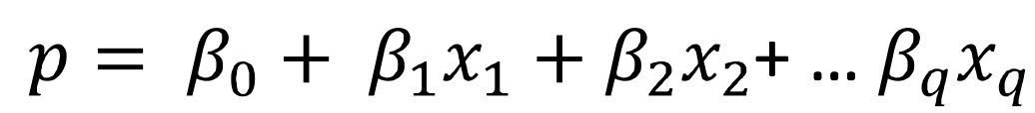
Step 1: Logistic Response Function
p = probability of belonging to class 1
Need to relate p to predictors with a function that guarantees 0 <= p <=1
Standard linear function (as shown below) does not constrain the probability:
q = number of predictors
Equation 10.1 in textbook

Slide 5
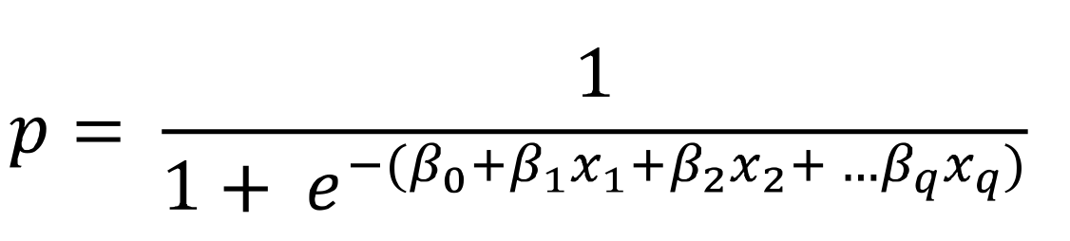
The Fix: use logistic response function
Equation 10.2

Slide 6
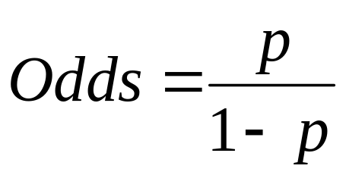
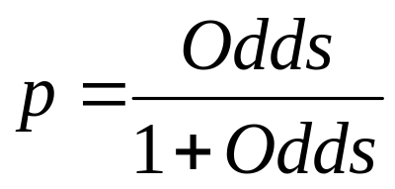
Step 2: Calculate the Odds
The odds of an event are defined as:
p = probability of event
Or, given the odds of an event, the probability of the event can be computed by:
Equations 10.3 and 10.4

Slide 7
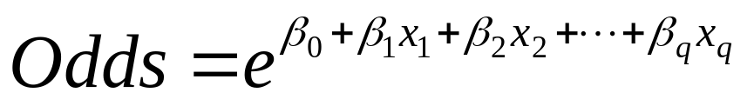
We can also relate the Odds to the predictors:
To get this result, substitute 10.2 into 10.4
Equation 10.5

Slide 8
Step 3: Take log on both sides
This gives us the logit:
log(Odds) = logit
Equation 10.6

Slide 9
The Logit
The logit is a linear function of predictors x₁, x₂, …
Takes values from -infinity to +infinity
Review the relationship between logit, odds and probability

Slide 10
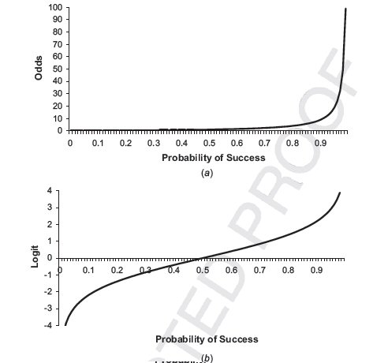
Odds (a) and Logit (b) as function of P

Slide 11
Example

Slide 12
Personal Loan (Universal Bank)
Outcome variable: accept bank loan (no = 0/yes = 1)
Predictors: Demographic info, and info about the customer relationship with the bank

Slide 13
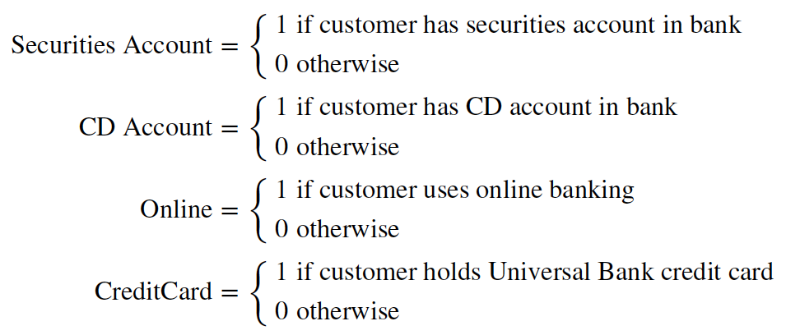
Data preprocessing
Partition 60% training, 40% validation
The data set includes four 2-level categorical predictors that have been coded as 0/1 dummy variables– these variables have the Continuous modeling type
Notes:
Dummy coding is not necessary in JMP.

Slide 14

Single Predictor Model
Modeling loan acceptance on income (x)
Fitted coefficients (more later): b₀ = -6.3525, b₁ = -0.0392

Slide 15
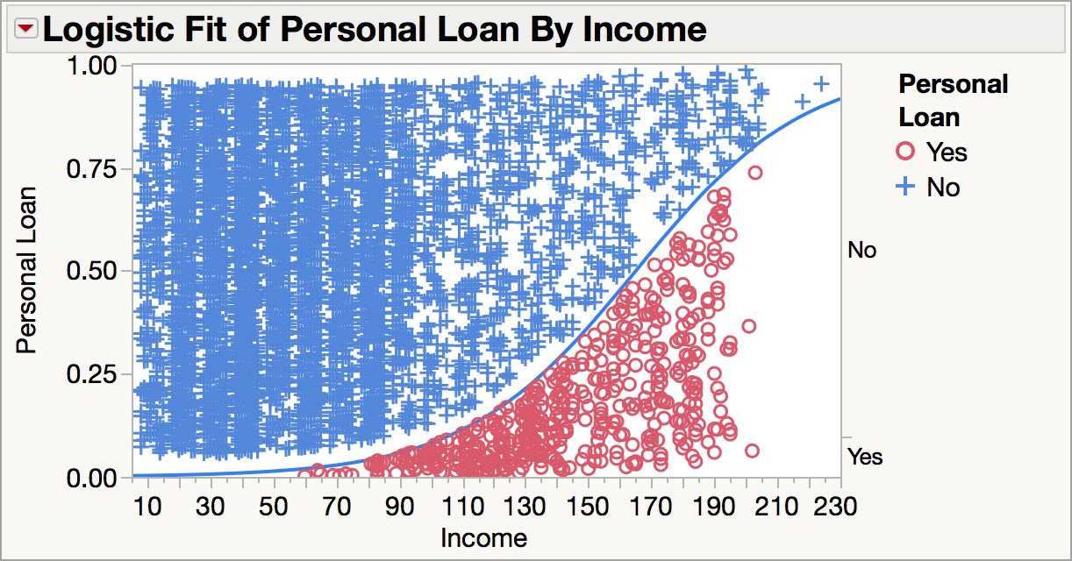
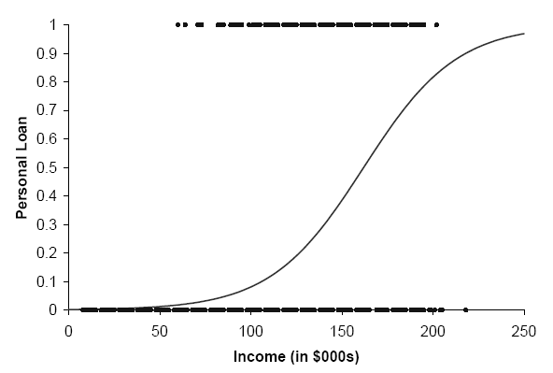
Seeing the Relationship (JMP)

Slide 16
Seeing the Relationship
Note that the logistic curve is often represented like the one below (in other software packages)

Slide 17
Last step - classify
The logistic model produces an estimated probability of being a yes (or a 1)*.
Convert to a classification by comparing the estimated probability to a cutoff value
The default cutoff value is 0.50
If the estimated probability > 0.50, classify as “yes”
*Note: By default JMP will model the probability of the first category (alphanumerically). To model the probability of 1 rather than the probability of 0, use the Value Ordering column property. In JMP 13 the target category can be specified in the platform.

Slide 18
Ways to Determine Cutoff
A cutoff of 0.50 is the default
Additional considerations (see Chapter 5)
  Maximize classification accuracy
  Maximize sensitivity (subject to min. level of specificity)
  Minimize false positives (subject to max. false negative rate)
  Minimize expected cost of misclassification (need to specify costs)
Notes:
The Alternate Cutoff Confusion Matrix add-in can be used to change the cutoff (https://community.jmp.com/docs/DOC-6901).

Slide 19
Universal Bank Example, continued
Estimates of β’s are derived through an iterative process called maximum likelihood estimation
We now fit a full model including all predictors
JMP reports coefficients for the logit in the Parameter Estimates Table
Options like Odds Ratios are available under the red triangle

Slide 20
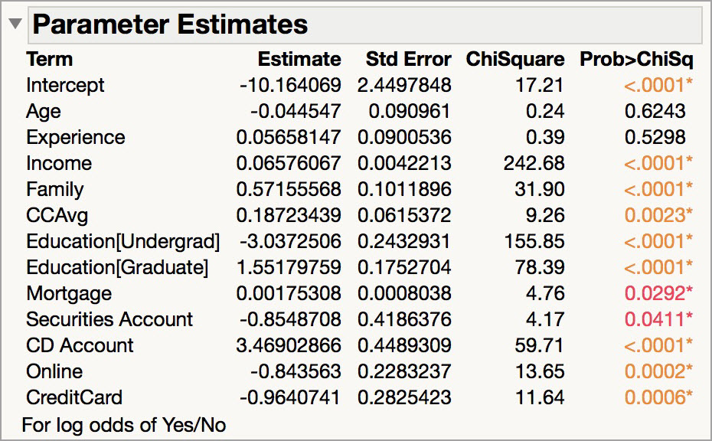
Universal Bank Example, continued
Estimated coefficients
Notes:
The model includes one 3-level categorical predictor (Education), which has stored values 1, 2, and 3. JMP estimates coefficients for 2 of the categories, omitting the highest level (3 = professional)

Slide 21
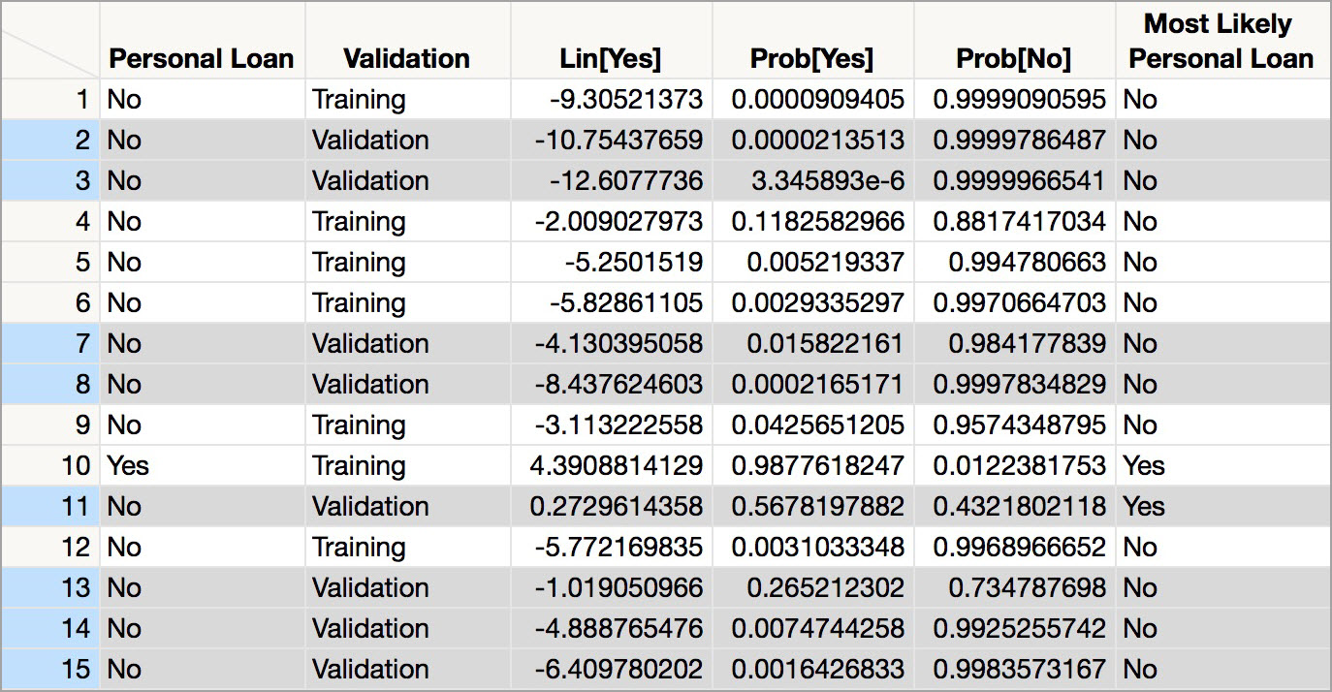
Universal Bank Example, continued
When the logit is saved to the data table, JMP calculates estimated probabilities, and uses a 0.50 cutoff to classify records (in the Most Likely column)

Slide 22
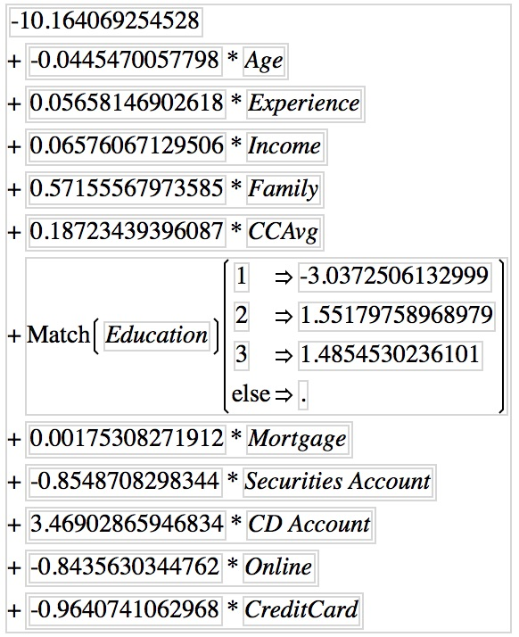
Universal Bank Example, continued
Estimated equation for the logit (equation 10.9)
Notes:
To see the equation, save the probability formula to the data table – the equation is stored in the lin[yes] column.

Slide 23
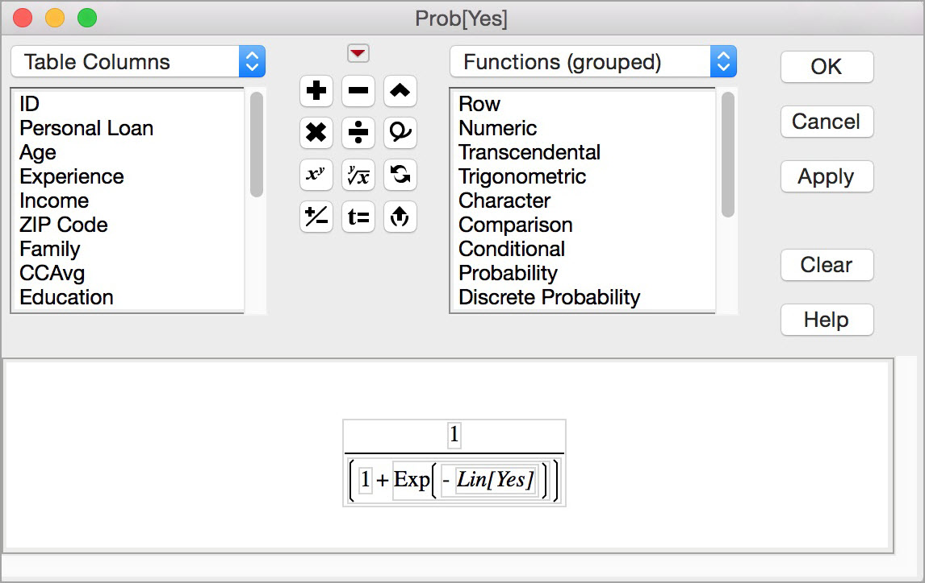
Universal Bank Example, continued
The logistic response function (Equation 10.2) is used to calculate the probabilities (propensities)
Notes:
Stored in the Prob[Yes] column when the probability formula is saved to the data table.

Slide 24
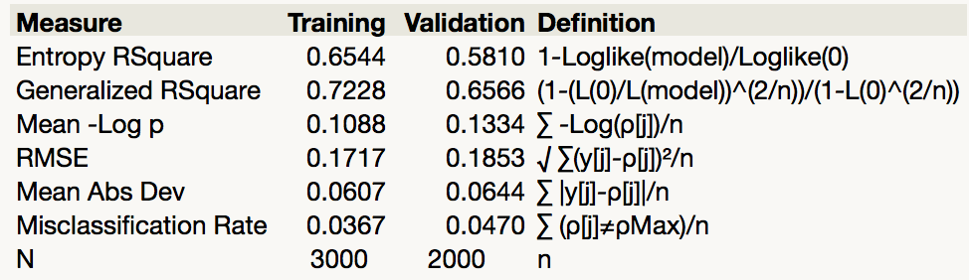
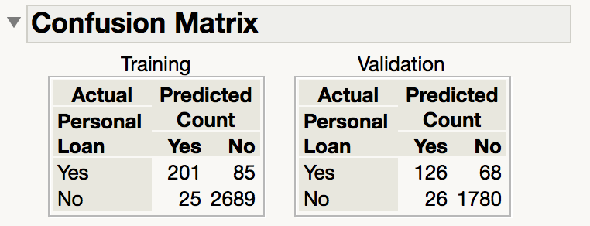
Evaluating Classification Performance
Performance measures: Confusion matrix and % of misclassifications for the validation set

Slide 25
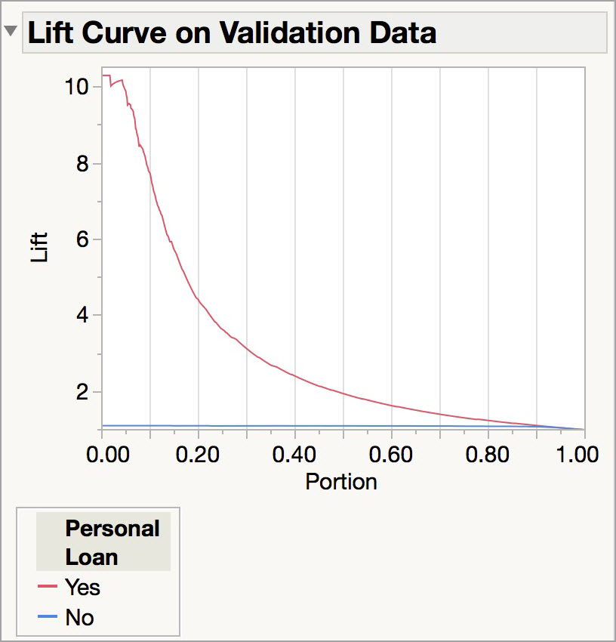
Evaluating Classification Performance
The rate for the target category is low (<10%)
So, more useful in this example is: lift
The lift for the top 10% of the sorted probabilities (Yes) = 7.7

Slide 26
Multicollinearity
Problem: As in linear regression, if one predictor is a linear combination of other predictor(s), model estimation will fail
  Note that in such a case, we have at least one redundant predictor
Solution: Remove extreme redundancies (by dropping predictors via variable selection – see next, or by data reduction methods such as PCA)

Slide 27
Variable Selection
This is the same issue as in linear regression:
The number of correlated predictors can grow when we create derived variables such as interaction terms (e.g. Income x Family), to capture more complex relationships
Problem: Overly complex models have the danger of overfitting
Solution: Reduce variables via automated selection of variable subsets (as with linear regression)
  Data preparation strategies (e.g. grouping or binning) can also reduce the number parameters to be estimated

Slide 28
P-values for Predictors
Test null hypothesis that coefficient = 0
Useful for review to determine whether to include variable in model
Key in profiling tasks, but less important in predictive classification

Slide 29
Complete Example:
Predicting Delayed Flights DC to NY

Slide 30
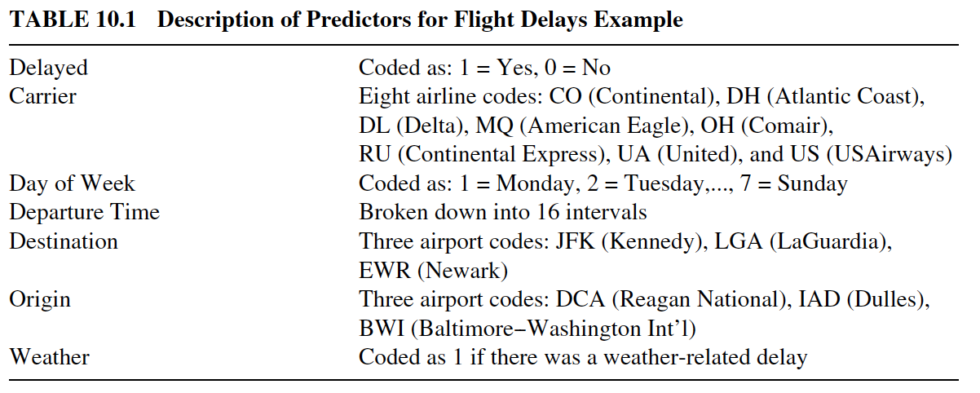
Flight Delays: The Variables
Goal: Create a model to predict flight delays as a function of several predictors

Slide 31
Flight Delays: Data Preprocessing
Partition 60%-40% into training/validation
Use graphical and numeric summaries to understand data and identify variables in need of recoding or reformatting
Some steps taken:
  Tell JMP to model the probability of 1 = Delayed
  Bin the departure time data into one hour increments (Formula Editor)
  Use bar charts and heat maps to identify categories that can be grouped

Slide 32
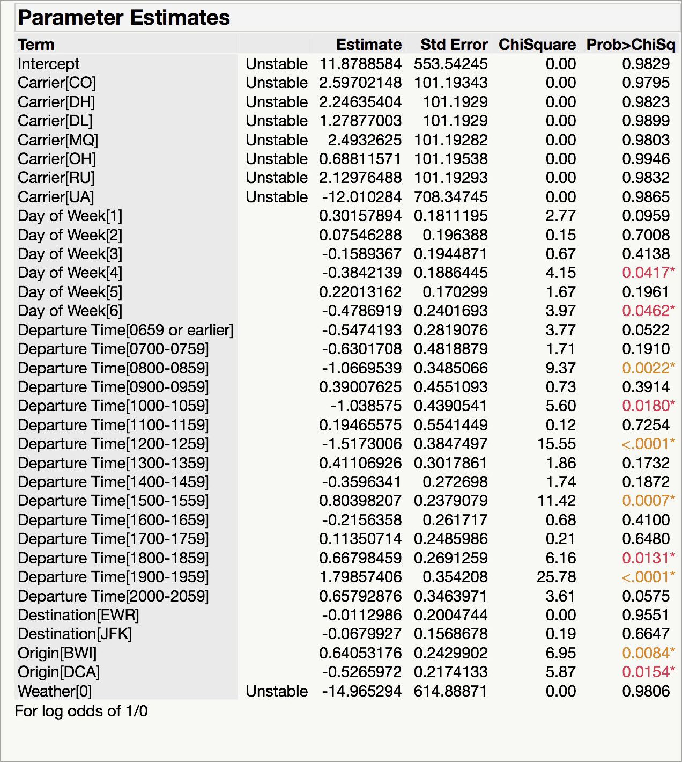
Flight Delays: The Fitted Model

Slide 33
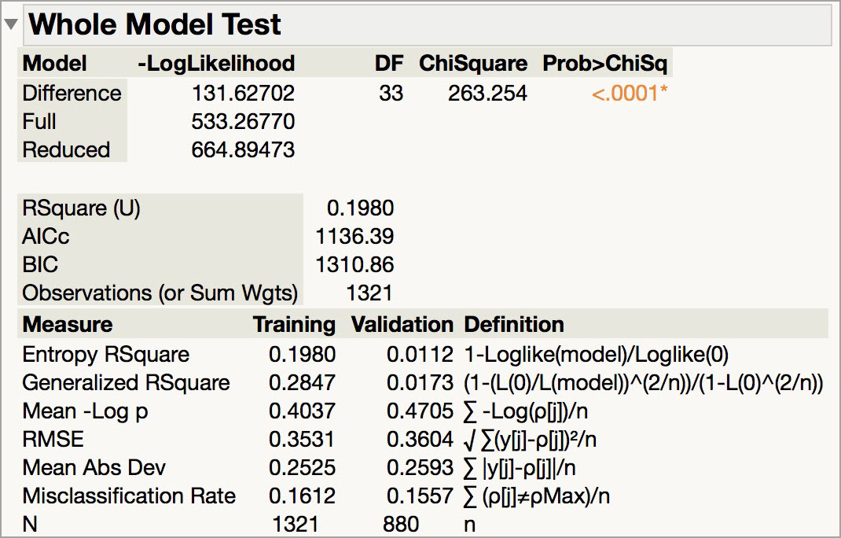
Flight Delays: Fit Statistics

Slide 34
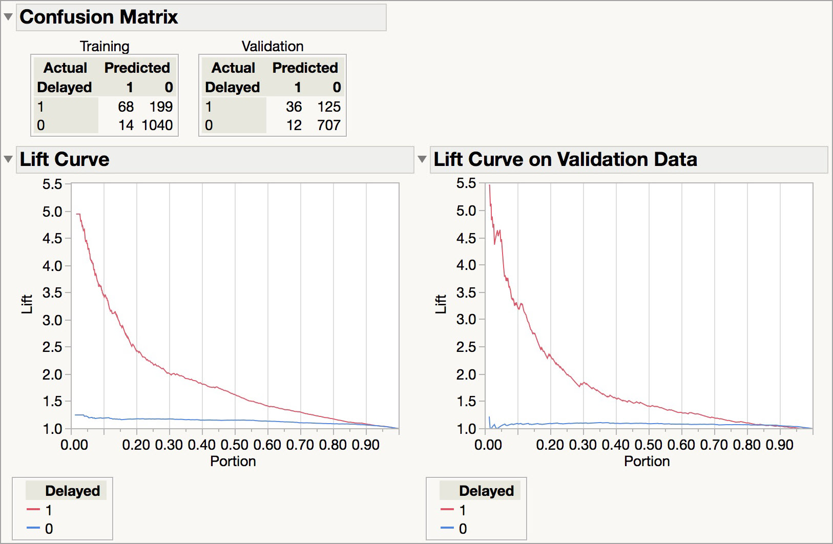
Flight Delays: Confusion Matrix and Lift

Slide 35
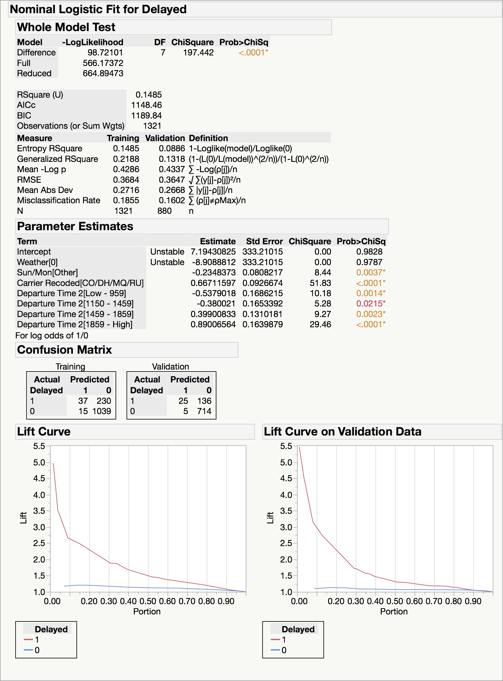
Flight Delays: Reduced Model (7 predictors)
Note that Weather is unknown at time of prediction (requires weather forecast or dropping that predictor)

Slide 36
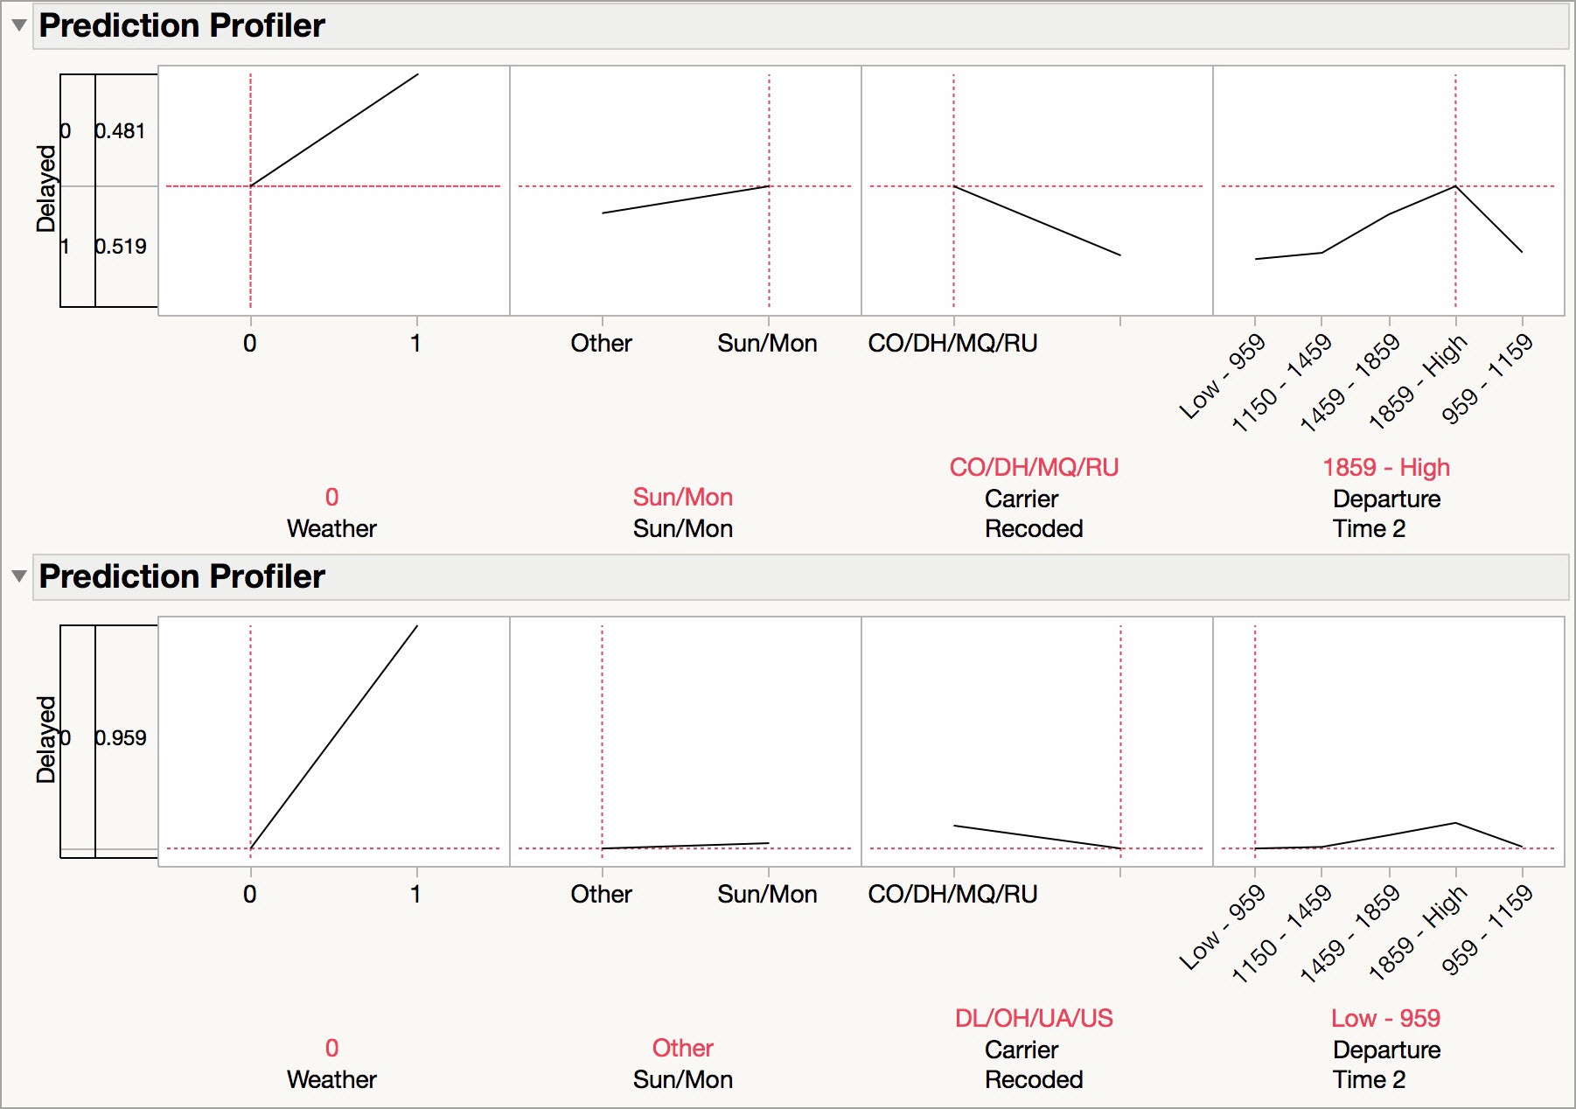
Flight Delays: Reduced Model
The Prediction Profiler showing best (bottom) and worst (top) conditions for flight delays

Slide 37
Summary
Logistic regression is similar to linear regression, except that it is used with a categorical response
It can be used for explanatory tasks (=profiling) or predictive tasks (=classification)
The predictors are related to the response Y via a nonlinear function called the logit
As in linear regression, reducing predictors can be done via variable selection
Logistic regression can be generalized to more than two classes (ordinal or multinomial)

